Slide 1

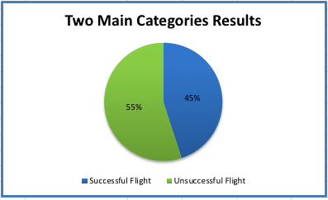
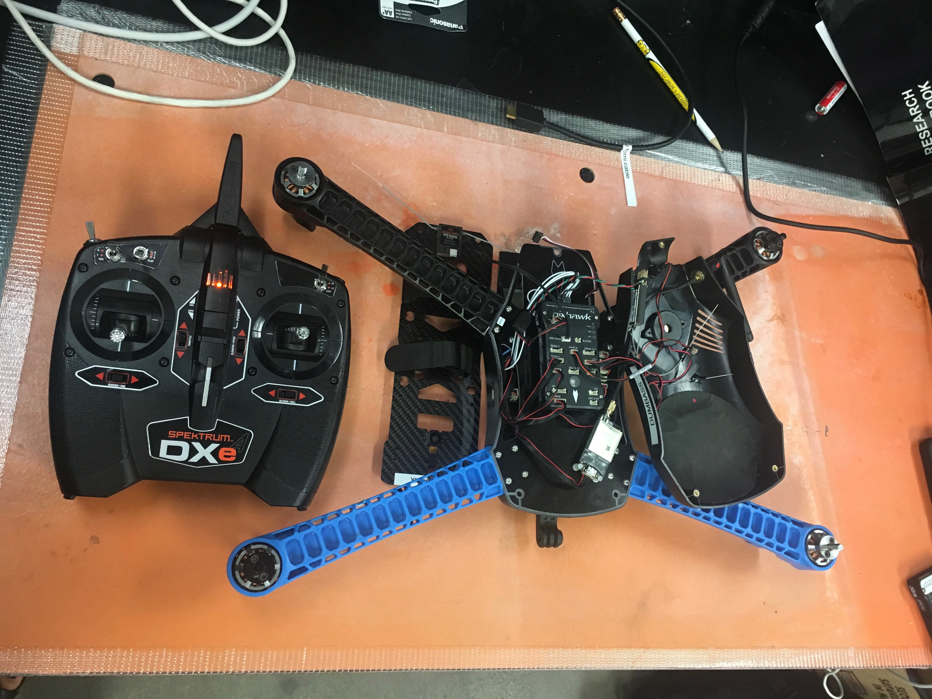
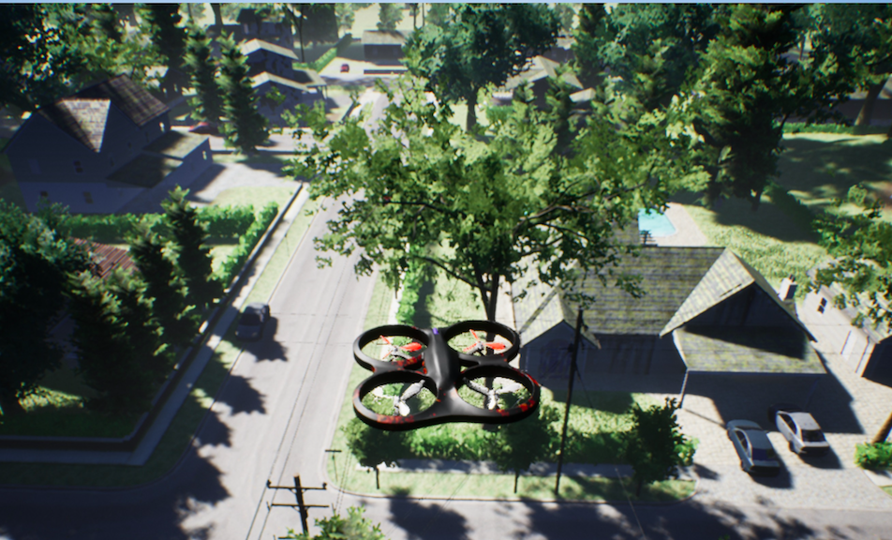
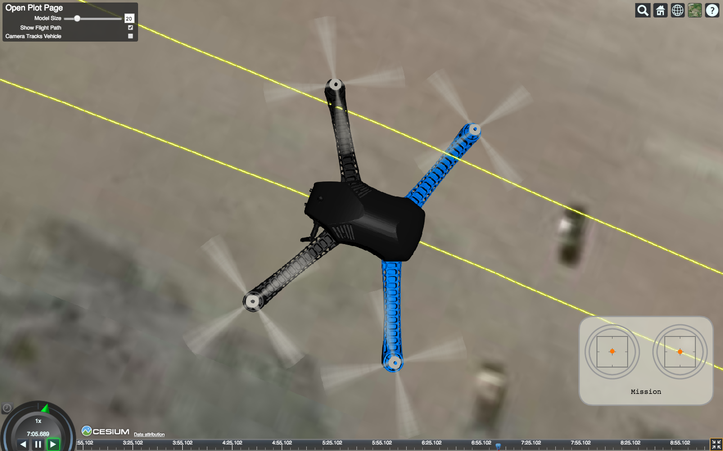
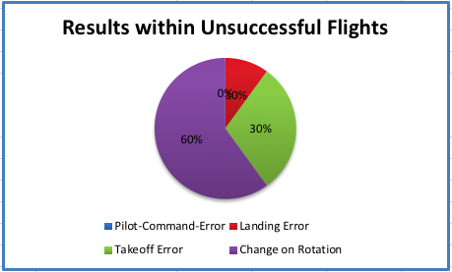
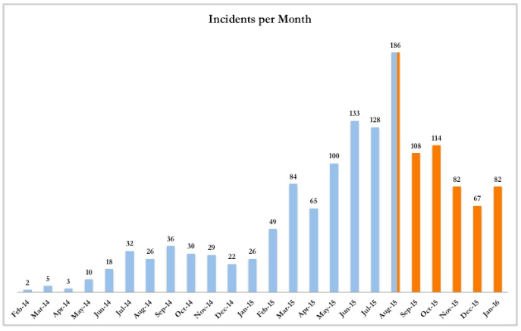
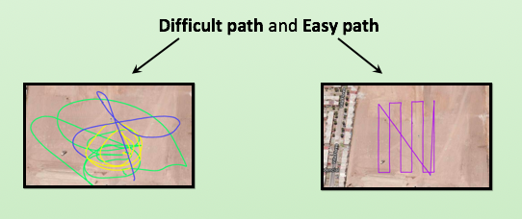
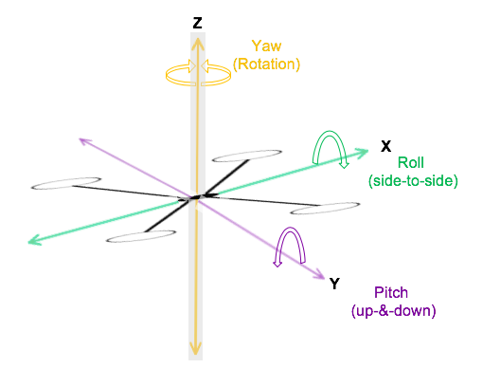
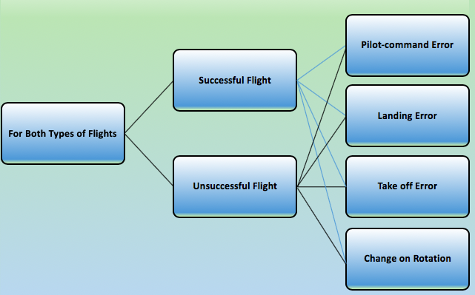
Flight Patterns Classification and Error Estimation for Small
Unmanned Aerial Systems
Yasmin Ochoa¹, Jose Alcala², Yang Quang Cheng, Ph.D²
¹Cañada College
²University of California, Merced: Dept. of Engineering
Background
Methods
Introduction
Results
Conclusions and Future Studies
In the past few years, small Unmanned Aerial Systems (sUAS) have become the target for consumer interests like delivery of packages, military, and industry uses. In order to make sUAS available for more widespread commercial uses, the safety of these systems must be improved by adding another security platform. In order to contribute to this goal, this project gathered information about patterns in successful and unsuccessful drone flights.
The data analyzed is from previous simulations that have being done thought Airsim Simulator.
The harder the path, the more likely an unsuccessful flight will happen.
Further studies of the yaw angle are needed because it is the main factor for change in rotation error.
For more precise data, future studies should conduct real-life flights in order to incorporate environmental and pilot-command factors into analysis.
Used px4 to analyze flight data generated by AirSim simulator.
The easiest paths had 90% successful flights and 10% unsuccessful.
All of the difficult paths had unsuccessful flights.
References
Background
From Federal Aviation Administration
[1] Guoxiang, Zhang. “Embedding Consequence Awareness in Unmanned Aerial Systems with Generative Adversarial Networks” 1-6.
[2] Poissant, Andrew. “Ground Impact and Hazard Mitigation for Safer UAV Flight Response” 1075-1084.
[3] Williams, Kevin W. “ A summary of Unmanned Aircraft Accident/Incident Data: Human Factor implications” 1-14.
[4] G. Morgenthal and N. Hallermann. “Quality Assessment of Unmanned Aerial Vehicle (UAV) Based Visual Inspection of Structures” Advances in Structural Engineering Vol. 17 No.3 (2014).
Analysis of the drone flights divided flights into two main categories.
Photo
Within the unsuccessful flights the common errors were take off and change in rotation.
Pilot-command error was not considered as a factor because flights were simulations.
The most common error was change in rotation, due to the loss of control of the yaw angle.
Total of 1437 drone flights accidents
8.1% of all accidents occurred at or below 400 feet while 91.9% occurred above 400 feet.
Aug-15 through Jan-16 there is a decrease in drone accidents due to increase in regulations, not improved drone safety
Within the two main categories, other subcategories were considered.
Acknowledgments
Objectives
Minority Science and Engineering Improvement Program (MSEIP)
ASPIRES and UROC for giving me the opportunity to do this internship
Graduate Student: Jose Alcala
Professor: Yang Quang Cheng
Mentors; Amelito Enriquez, Bill Gomez, and Sally Treanor
Analyze flight data to determine factors that make a good or bad flight.
Find new interpretive methods to create more accurate subcategories of flight data that can be incorporated into machine learning platforms.
Use findings to determine patterns that might be applied to machine learning to improve safety of drone flights in the future.
Rapid altitude changes contribute to change in rotation errors because the higher the altitude, the harder it is to control the yaw angle, which in most cases ends in collision.
Contact
Yasmin Ochoa yochoa3@my.smccd.edu

